Slide 1
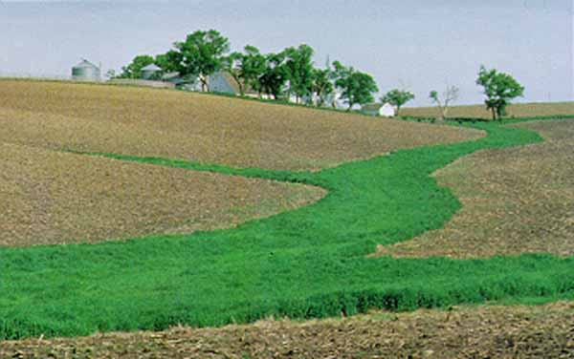
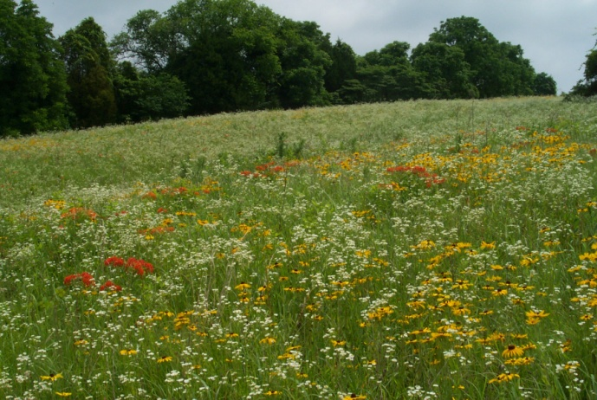
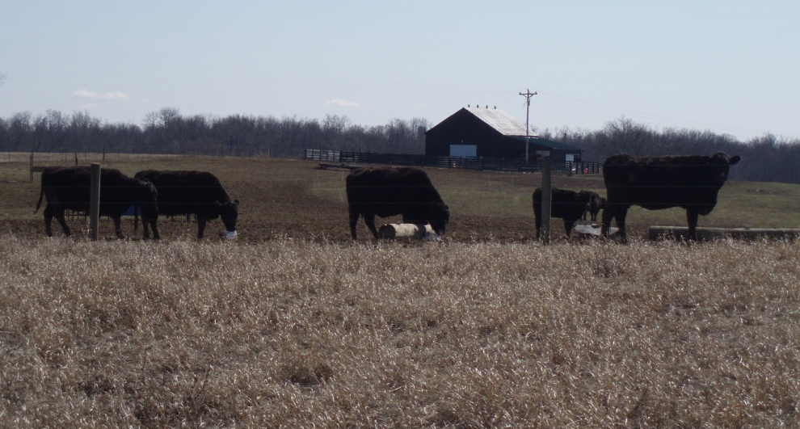
Conservation Planning
&
Cost Share Programs
Presented by- John Stork

Slide 2
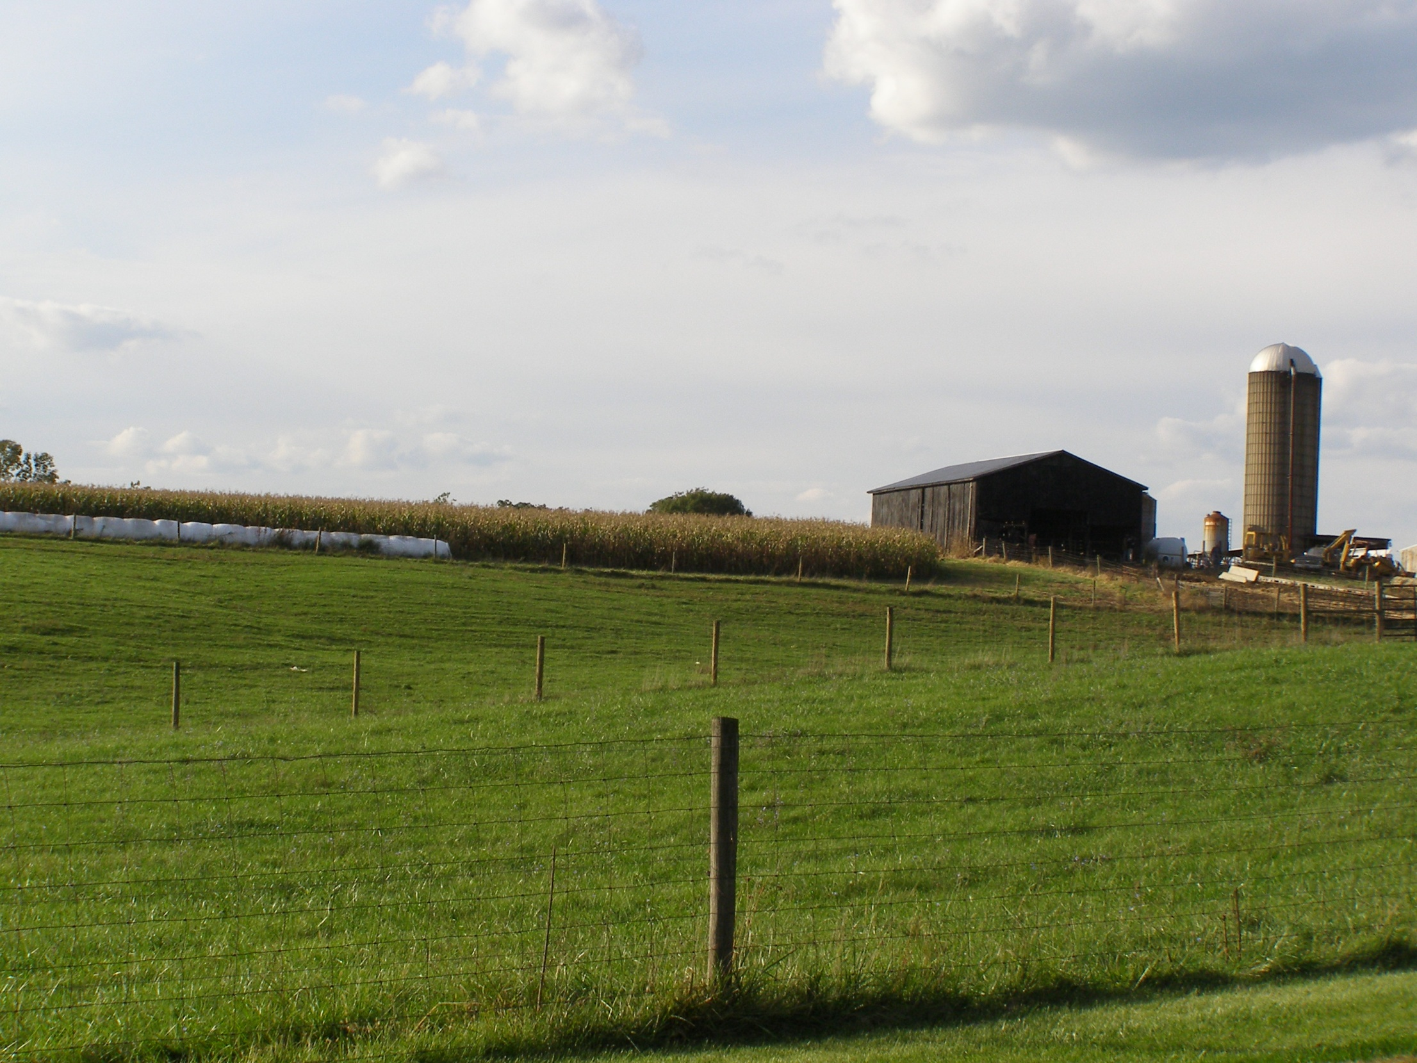
NRCS Mission:
Help People Help the Land

Slide 3
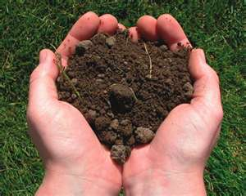

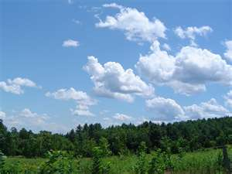
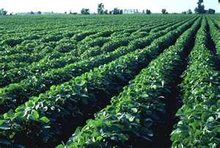
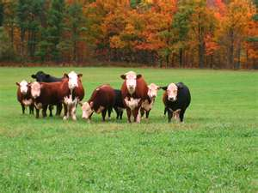
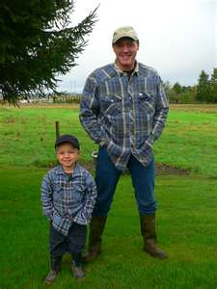

On-Site Farm Visit to Develop Conservation Plan
9 Step Planning Process
Identify Problems
2. Determine
Objectives
3. Inventory Resources
S
W
A
P
A
+
H
+
E
soil
water
air
plants
animals
energy
humans

Slide 4
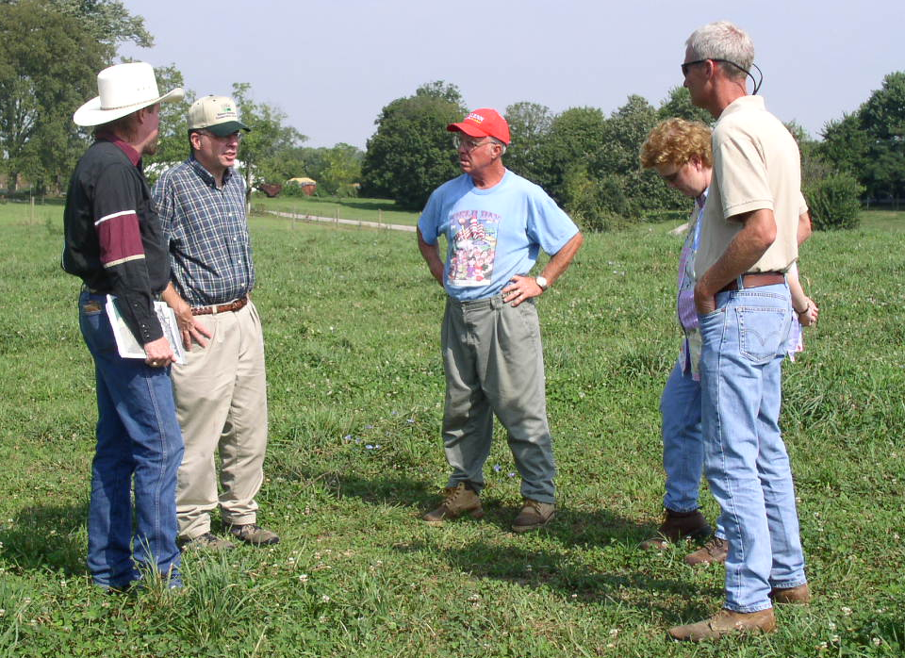
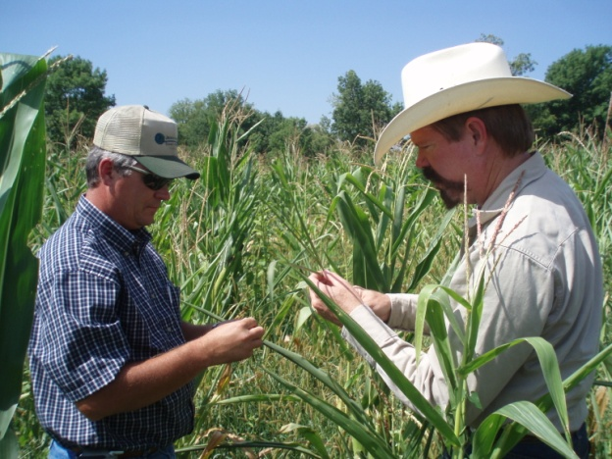
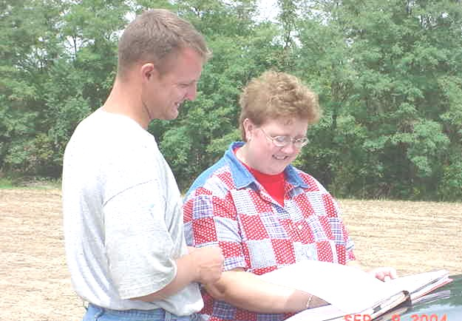
9 Step Planning Process
4. Analyze Resource Data
5. Formulating Alternatives
6. Evaluating Alternatives
7. Make Decisions
8. Implement the Plan
9. Evaluate the Plan

Slide 5
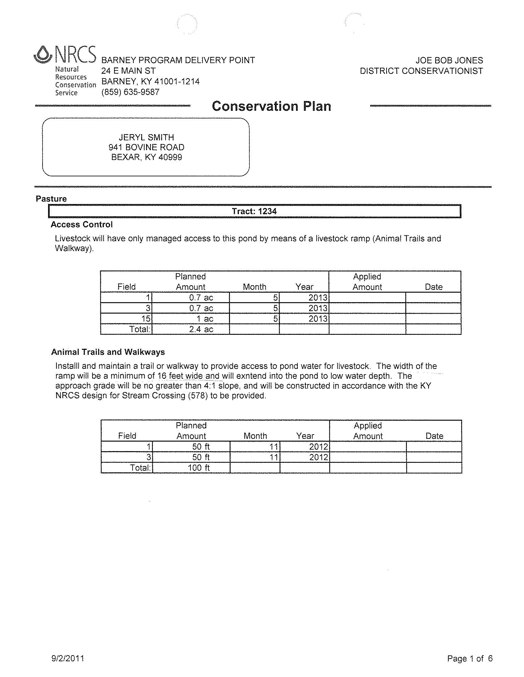
Conservation Plan Map and Conservation Plan

Slide 6
Can NRCS Programs
help complete your Plan??
EQIP – Environmental Quality Incentives Program
CRP – Conservation Reserve Program
CSP – Conservation Stewardship Program

Slide 7
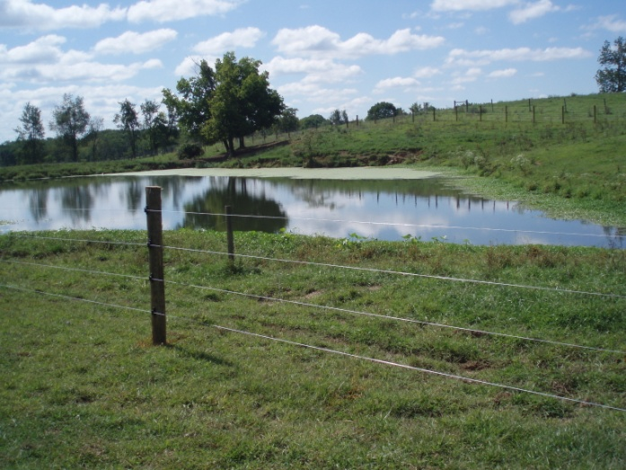
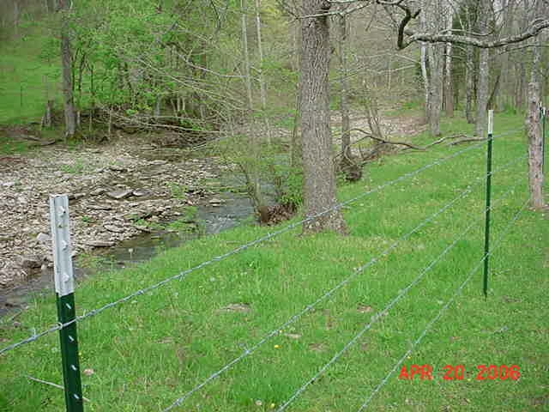
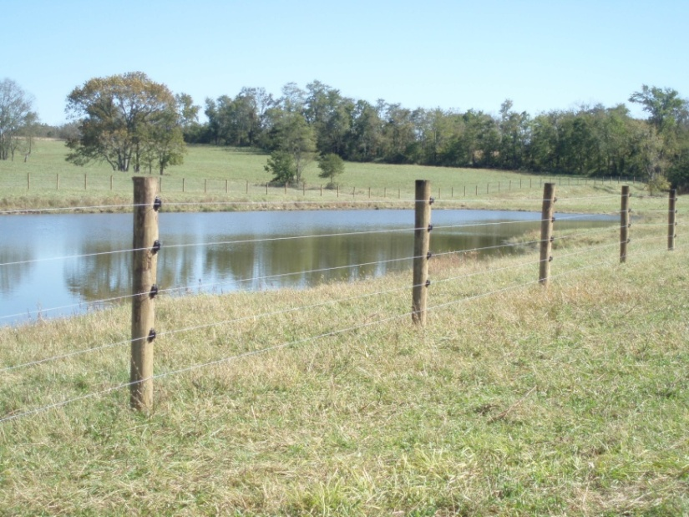
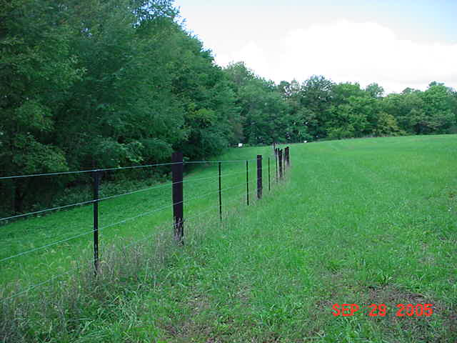
Fencing
(sensitive areas: creeks, ponds, woodland)

Slide 8
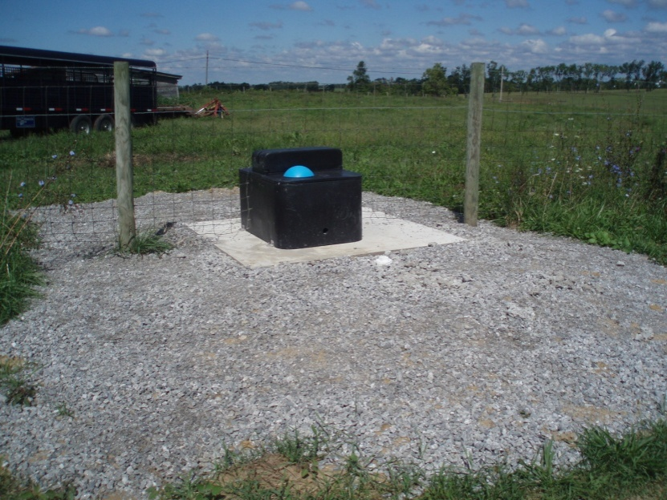
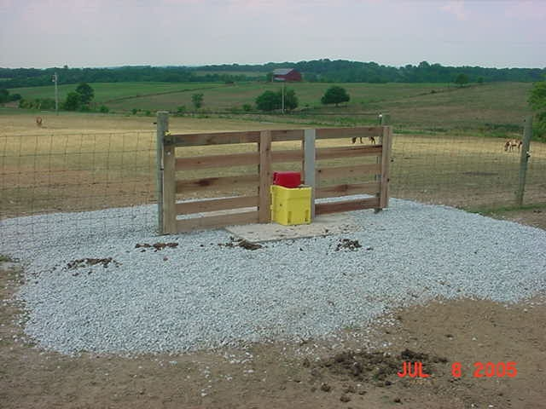
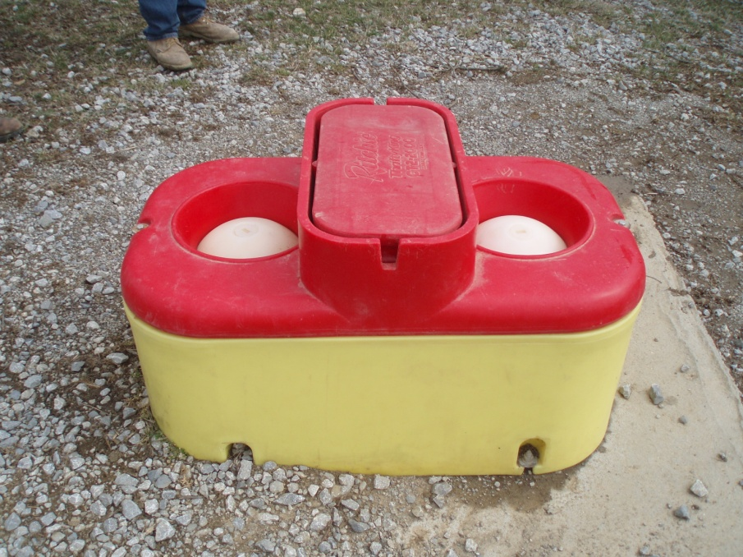
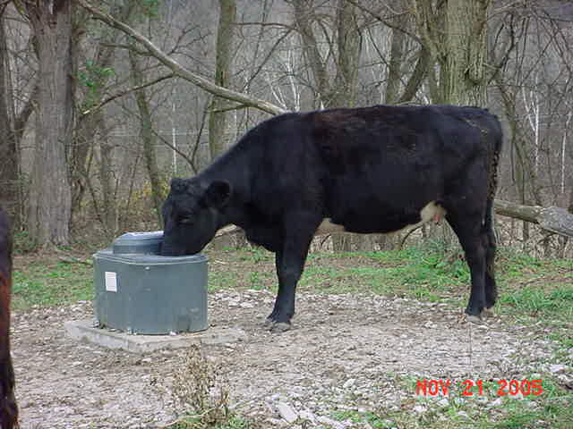
Livestock Watering Facilities

Slide 9
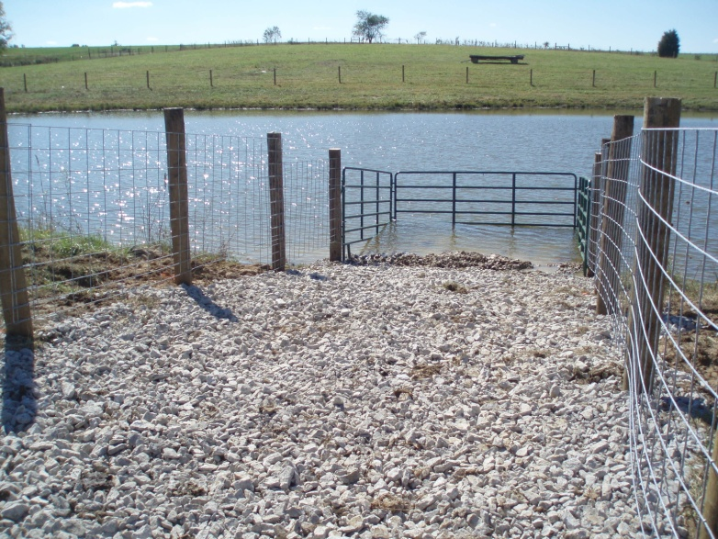
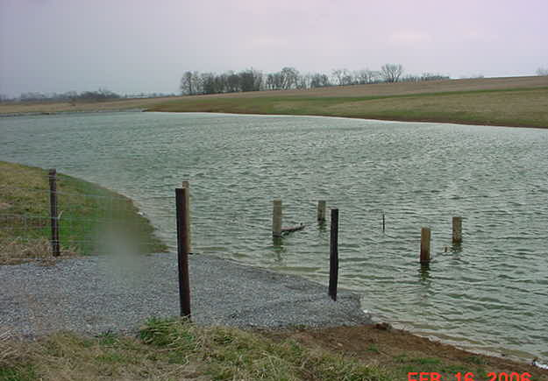
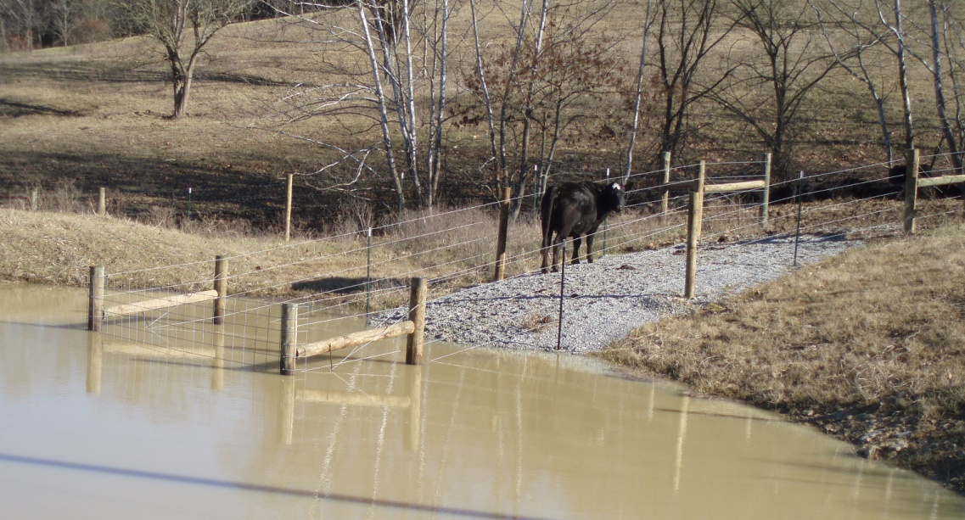
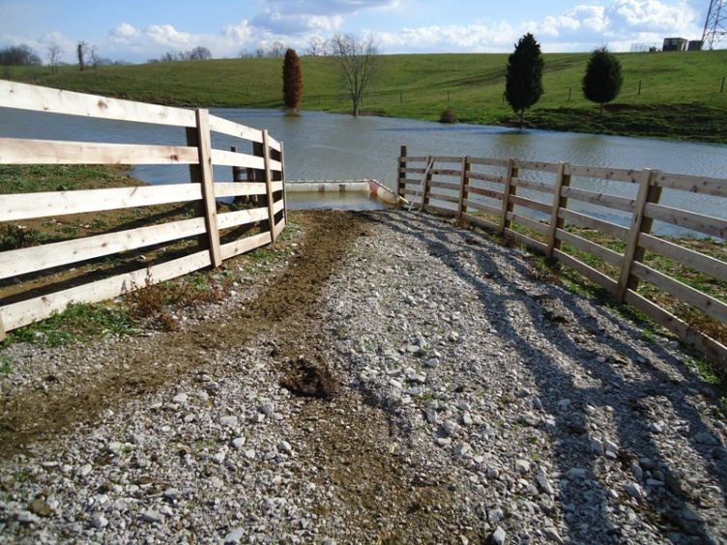
Livestock Watering Facilities
(access ramp)

Slide 10
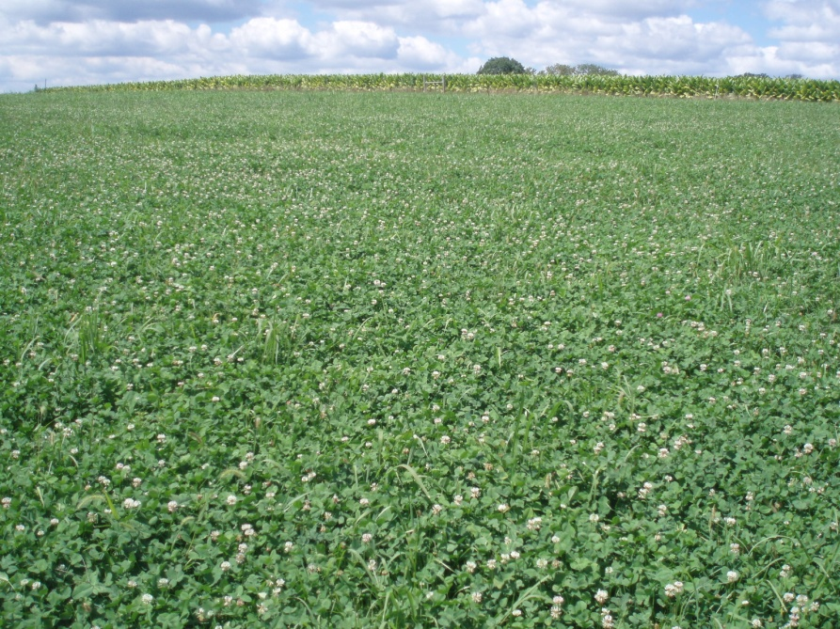
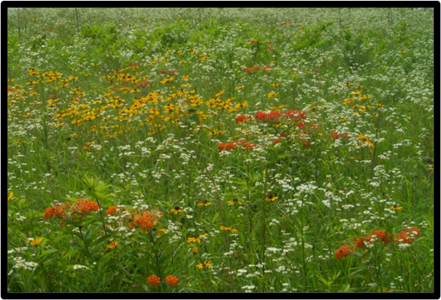
Grass and Forb Plantings
Forage and Biomass Planting
Filter Strip
Conservation Cover
Critical Area Planting

Slide 11
Program Specifics:
*Applications taken any time of year
*Funding typically offered once per year
*Resource based scoring, NOT first come first served
*Has to address resource concern(s), cannot be strictly
for increasing production

Slide 12
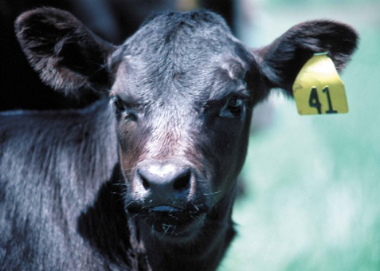
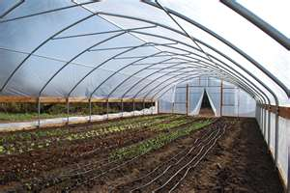
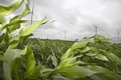
State Cost Share
(SCS)
Funding for practices are approved by the Soil and Water Conservation Commission at the Kentucky Division of Conservation, located in Frankfort, as funds are available.
Funds for new practices only, and cannot be applied to practices that have already been started.
Approved applicants will have one year to complete practices.

Slide 13
What Now??
Contact your County Conservation District or your local NRCS office to set up a site visit for your property and complete a conservation plan.
Cost-share applications can be filled out for eligible practices in your conservation plan (applications are taken on an on-going basis but have specific cut-off periods for ranking).
Stop by your local Farm Service Agency (FSA) office to update your eligibility for USDA programs.

Slide 14
Thank You!
John Stork
Soil Conservationist
USDA-NRCS
6028 Camp Ernst Rd. Burlington, Ky. 41005
859-586-7903 ext. 6275

